Slide 1
Z1146 - ENTREPRENEURSHIP II
SESSION V
OPERATIONS MANAGEMENT

Slide 2
Learning Objectives
LO 1 : Creating an innovative business model
LO 2 : Generate business strategies to make a sustainable business

Slide 3
Overview

Slide 4
Operation Management
The process by which a firm makes a product. This can be either a tangible item (goods) or intangible commodity (service). (Schaper, 2011)
Operations management refers to the administration of business practices to create the highest level of efficiency possible within an organization. (Investopedia)
Operations management involves planning, organizing, and supervising processes, and make necessary improvements for higher profitability. (Cleverism, 2016)

Slide 5
Operation Management
Input
Transformation Process
Output

Slide 6
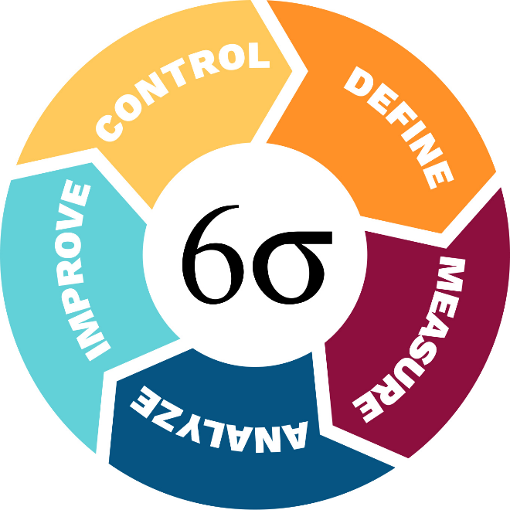
Six Sigma
A quality-improvement and cost-reducing method that focuses on customer satisfaction
It is achieved if only 3.4 defects are found in a million of output
http://www.wesleyancollege.edu/images/sixsigmacircle_24184.jpg

Slide 7
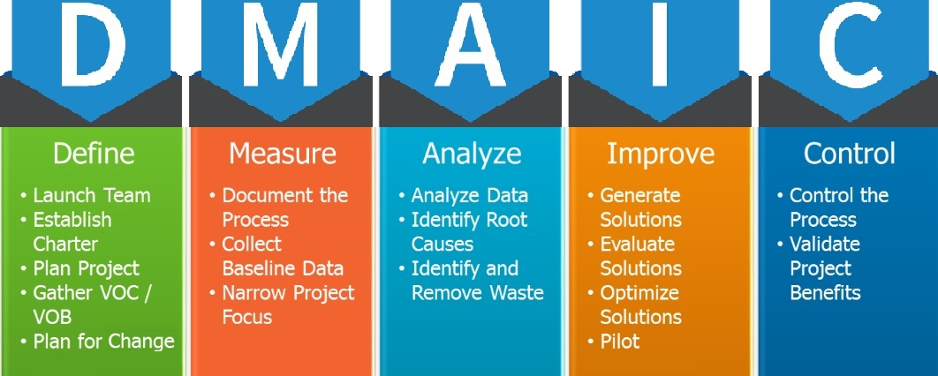
Six Sigma
http://taskoconsulting.com/tag/dmaic-process/

Slide 8
Scheduling Mechanism

Slide 9
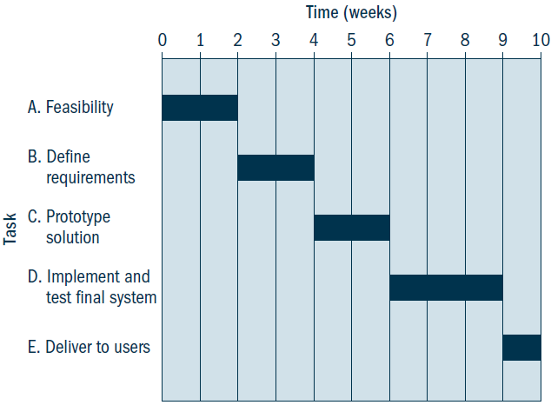
Gantt Chart
To develop visual depictions of time frames for tasks that have a chronological overlap and/or multiple actors
A Gantt chart (Schaper, 2011)

Slide 10
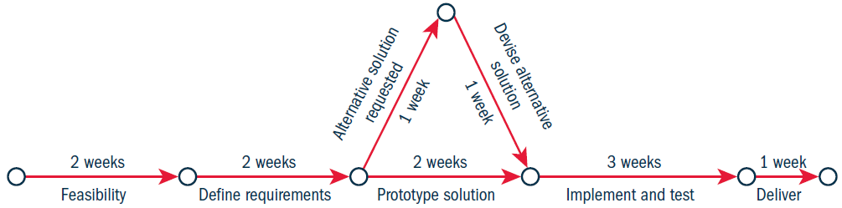
PERT
PERT (performance evaluation and review technique) chart is useful to identify the critical path that dictates the rate of progress for more complex projects
A PERT chart (Schaper, 2011)

Slide 11

Case
GOJEK
https://youtu.be/MYYf8s_ZouE
How does Gojek manage its operation and how does it help its customers’ operational management?

Slide 12
References
Anastasia. (2016). Operations Management: Definition, Principles, Activities, Trends. Retrieved December 3, 2017, from https://www.cleverism.com/operations-management-definition-principles-activities-trends/
Operations Management. (n.d.). Retrieved December 3, 2017, from https://www.investopedia.com/terms/o/operations-management.asp
Schaper, Michael.(2011). Entrepreneurship and Small Business 3-rd Asia-Pasific Edition. John Wiley & Sons Australia, Ltd. Milton. ISBN: 978-1-74216-462-5

